Slide 1
INTERACTIONS WITH EUROPEAN MEDICINE AGENCY

Slide 2
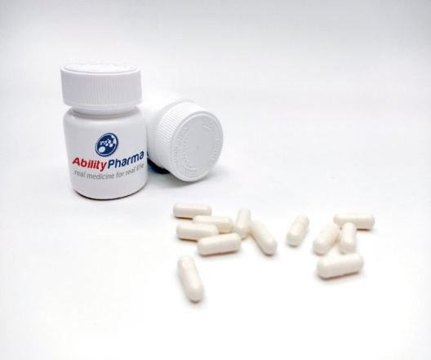
Leading the way in autophagy ABTL0812 a pioneering approach to cancer treatment
Who we are?
Innovative Mechanism of Action
Triple Antitumor Effect
Positive Phase 2a Results
Phase 2b Ongoing
Broad IP portfolio
PANCREATIC CANCER (PDAC)
Double-blind placebo-controlled
USA – FRANCE - SPAIN ISRAEL
AUTOPHAGY
SYNERGY with CT
Turns tumors from COLD to HOT immunogenic
ENDOMETRIAL & LUNG CANCER
ORR ↑ PFS ↑ OS↑
Lung: 11,2 mo→22,3 mo
SPAIN - FRANCE
NEW CHEMICAL ENTITY
Chemical synthesis
ORAL SOLUTION
CAPSULES
ABTL0812 selectively kills cancer cells through AUTOPHAGY
EMA SME status granted in 2012, with yearly renewals
Orphan drug designation (ODD) for pancreatic cancer, bliliary cancer and neuroblastoma
EIC Accelerator pilot grant (H2020) blended financing first applied in Jan 2020, granted in March 2020 (5.2 M €). Grant # 954825 - PanC-ASAP

Slide 3
Historical Development Timeline
2009 - 2011
2012 - 2013
2014 - 2016
2017 - 2020
2021– To Date
Discovery
Preclinical development
Phase I
Phase II a
Phase II b
ODD Neuroblastoma (2015)
ODD Biliary Tract Cancer (2018)
Scientific Advice Neuroblastoma (2014)
PRIME Endometrial Cancer (2019)
First ODD Application Pancreatic Cancer (2011)
ODD Pancreatic Cancer (2017)
Protocol Assistance
Pancreatic Cancer (2021)

Slide 4
Our interactions with the EMA – ODD example
2011: ODD pancreatic cancer request - WITHDRAWN
2011
2012
NOVEMBER
JANUARY
APRIL
Request and pre-submission meeting request
Pre-submission meeting & Submission
COMP meeting
Hearing to the Sponsor
Application withdrawn
Feedback provided: Significant benefit data limited
APPLICATION WITHDRAWN

Slide 5
Our interactions with the EMA – ODD example
2012: ODD pancreatic cancer request Lessons learned
Pre-submission meetings are useful to identify the submission weaknesses, BUT NO WARRANT OF SUCCESS
Prepare detailed list of questions
Meeting with EMA officers & Committee members permit high quality interactions
Instructions to re-apply: Demonstration of SIGNIFICANT BENEFIT IS KEY to succeed if other treatments are available.
FDA does not have significant benefit requirements
Notes:
Números o tics, es positivo

Slide 6
Our interactions with the EMA – ODD example
2017: New ODD pancreatic cancer request - APPROVED
2017
FEBRUARY
MAY
JULY
AUGUST
Request for pre-submission meeting
Submission
COMP positive feedback
EU Approval
MARCH
Pre-submission meeting
Tips for ODD maintenance:
Be aware that yearly renewals are required – annual report
Verify and test IT requirements for submission in advance

Slide 7
ABTL0812 phase 2b trial ongoing To assess safety and efficacy in Metastatic Pancreatic Cancer (PDAC)
Double blind, Placebo-controlled, Randomized, multicenter Dose-escalation Study of ABTL0812 administered Orally as a Combination Agent with SoC to Subjects with Metastatic Pancreatic Cancer EUDRA CT 2020-002791-13
FOLFIRINOX + ABTL0812
ABTL0812 single therapy
FOLFIRINOX + PLACEBO
PLACEBO
The trial could be transformed into phase 3 pivotal trial leading to an early approval expected in 2025

Slide 8
Our interactions with the EMA – Protocol assistance
Ability Pharmaceutical applied (January) for an EIC accelerator pilot grant for the development of ABTL0812 in pancreatic cancer (PanC-ASAP) - Granted in March 2020.
2021
JANUARY
APRIL
MAY
Protocol assistance requested (Preclinical & Clinical questions)
Request for clarification
Response for the clarifications
MARCH
Response from EMA
Feedback provided: All interactions were in writing
Lack of opportunities for dialog through F2F meetings or video-conference

Slide 9
Our interactions with the EMA – Protocol assistance
2021: Protocol Assistance Lessons learned
Feedback received permits to re-design the protocol to meet requirements for an accelerated approval
Clear questions – Clear answers
Always try to have a meeting (video-conference or face-to-face): Personal interactions allow to clearly present company positions and to clarify if needed
Notes:
Aquií números o tics

Slide 10
Thank you!
www.abilitypharma.com

