Slide 1
The parallel journeys from Academia to Company and from ITF to Scientific Advice
Poltreg S.A., Gdańsk, Poland
Department of Medical Immunology
Medical University of Gdańsk, Poland
Piotr Trzonkowski
EIC – EMA Info day 31.01.2023

Slide 2




Conflict of interest and support
This lecture presents IP owned by Med. Univ. Gdańsk
PT is CEO and stakeholder of POLTREG S.A.
Poltreg S.A. is the exclusive licensee of IP owned by Med. Univ. Gdańsk
STRATEGMED1/233368/1/NCBR/2014
LIDER/160/L-6/NCBR/2015
POIR.01.01.01-00-0769/15-01
H2020-EIC-SMEInst-2018-2020-2
Action to Focus and Accelerate Cell-based Tolerance-inducing Therapies (A FACTT)
www.poltreg.tech

Slide 3
Cell & gene therapy as Biotech 3.0
chance
of cure
Biotech 3.0
Cell&gene therapy
>10 years
complexity
Biotech 2.0
Biologicals/ proteins/ antibodies
>30 years
Biotech 1.0
Small molecules
>100 years
www.poltreg.tech

Slide 4
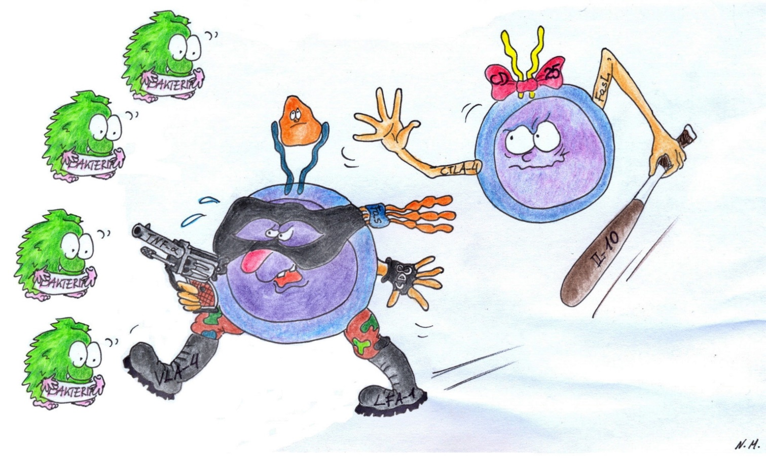
T regulatory cells CD4+CD25+ (T_{reg})
Treg
Effectors
www.poltreg.tech

Slide 5
Why T_{reg} in autoimmunity?
Self tissues
e.g. brain
Self tissues
e.g. islets
Self tissues
e.g. joints
Self tissues
e.g. gut
Effectors against self
www.poltreg.tech

Slide 6
From Academia to Company
Beginning of work at the Medical University of Gdańsk (GUM) on the use of T-regulatory lymphocytes (TREG) in the treatment of type 1 diabetes (DM1)
Co-financing from NCBiR (€1.5M) to increase the efficiency of the TREG multiplication process, and development of a strategy to enter the US market (GO_GLOBAL)
Horizon 2020 grant for the preparation of pivotal trial and registration granted by European Commission
Phase I trial in RRMS closed and reported
GUMed gained support from the research and development program - STRATEGMED, which covered the costs of treatment of 34 patients with DM1 and 12 patients with multiple sclerosis
Grant from the EU SME Instrument Phase 2 program (€2.5M)
Phase I trial in DM1 closed and reported
2004
2013
2014
2015
2016
2018
2019
2020
2021
2017
IPO –
100mln PLN
for future development
Grant of Polish patent for the use of the TREG method in DM1 (2014) and submission of applications in EU (2013) and USA (2014)
PolTREG established as a spin-off from the Medical University of Gdańsk (MUG)
EMP granted by the EMA to the status of ATMP and the resulting Hospital Exemption procedure
Filing of Pediatric investigation plan (in coop. with Parexel)
Scientific Advice EMA on further studies in DM1 received
Exclusive license from GUM for use of TREG method in DM1.
Commencement of HE therapies at GUM
www.poltreg.tech
Notes:
I suggest to move slide 7 and 8 straight after this slide and then talk about the solution (slide 5) DONE
6

Slide 7
Pipeline with clinical-stage Tregs projects
Therapeutic area | Indication | Research | Preclinical | Phase I | Phase II | Phase III | Regulatory | Next expected milestones
Type 1 Diabetes | Newly diagnosed patients (Stage 3 T1D) |  |  |  |  |  |  | Marketing authorisation
 | Presymptomatic patients (Stage 2 T1D) |  |  |  |  |  |  | Registration of the trial and regulatory steps H2’2022
Multiple Sclerosis | Relapsing-remitting |  |  |  |  |  |  | Clinical trial protocol Phase II Q3’2022
 | Primary progressive |  |  |  |  |  |  | Clinical trial protocol Phase II Q3’2022
Autoimmunity | Autoimmune diseases (T1D, MS, RA, transplantology, allergology, etc) |  |  |  |  |  |  | Validation of the product under GMP conditions, preclinical tests
PTG-007+ / rituximab
CD3+CD4+CD25+CD127-FoxP3+ Tregs
PTG-007
CD3+CD4+CD25+CD127-FoxP3+Tregs
PTG-007+ / tecfidera
CD3+CD4+CD25+CD127-FoxP3+Tregs
PTG-007
CD3+CD4+CD25+CD127-FoxP3+Tregs
PTG-020
(Tregs 2.0)
Antigen Specific Tregs
CAR-Tregs
Genetically modified
www.poltreg.tech
Notes:
There is no figure below here, please change the last bullet point or

Slide 8
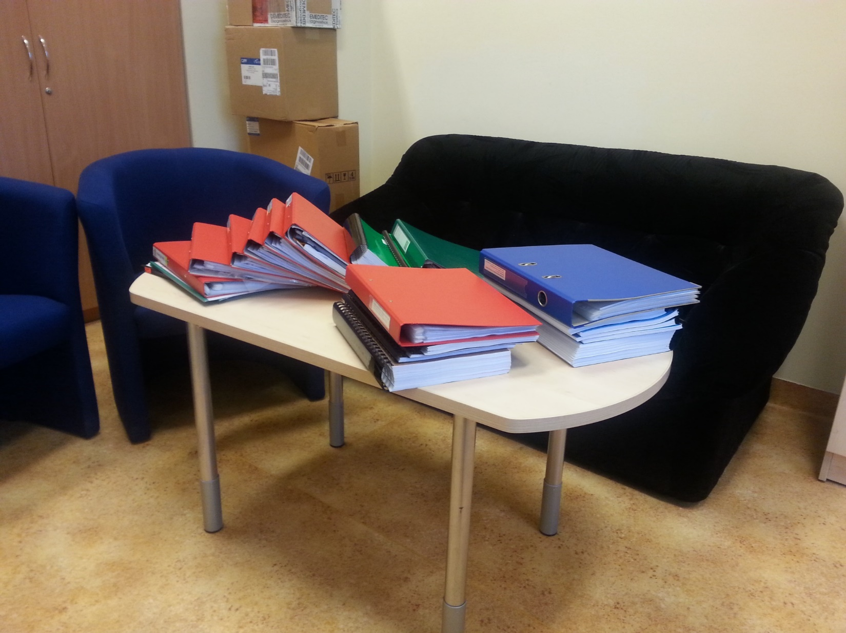
PolTREG: From Academia to Company
Rozp. MZ dot terapiach zaawansowanych
Ustawa o zawodzie lekarza
EMA/CAT/235374/2010).
Ustawa transplantacyjna
EMA/CAT/GTWP/671639/2008
Prawo farmaceutyczne
EMEA/149995/2008
Rozp.MZ dot. Banków komórek i tkanek
CommissionDirective2009/120/EC
EMEA/CHMP/410869/2006
Directive2004/23/EC
EMEA/CHMP/SWP/28367/07
Directive2001/83/EC
EMA/CAT/486831/2008
Directive2002/98/EC
CommissionRegulation(EC)N◦ 668/2009
Directive2001/20/EC
Regulation(EC)N◦ 507/2006
EMA/CAT/CPWP/686637/2011
Regulation(EC)N◦ 1394/2007
Regulation(EC)N◦ 726/2004
www.poltreg.tech

Slide 9
Natural history of a drug
Preclinical models
Toxicity Pharmacokinetics
ADME
In vitro
studies
GMP formulation
Clinical trials
Authorisation
The need
Idea
Aim
Support from the regulator
www.poltreg.tech

Slide 10
Costs of the development
of the drug
chance
of cure
complexity
Natural history of a drug
Support from the regulator
www.poltreg.tech

Slide 11
Natural history of a drug
Preclinical models
Toxicity Pharmacokinetics
ADME
In vitro
studies
GMP formulation
Clinical trials
Authorisation
The need
Idea
Aim
SA CMC
ITF
SA
PRIME
www.poltreg.tech

Slide 12
Creating GMP formulation of the drug requires funds. Manufacturing can be 10-100 times more costly than the research-use version
Manufacturing plant requires even more funds
There is no second chance, so it is better to ask before
Preclinical models
Toxicity Pharmacokinetics
ADME
GMP formulation/manufacturing
[CMC]
C – chemistry
M- Manufacturing
C - controls
In vitro
studies
The need
Idea
Aim
SA CMC
www.poltreg.tech

Slide 13
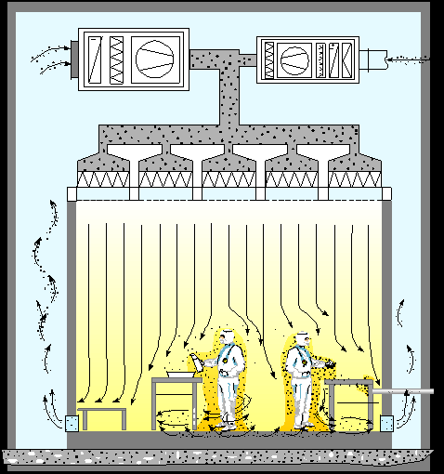
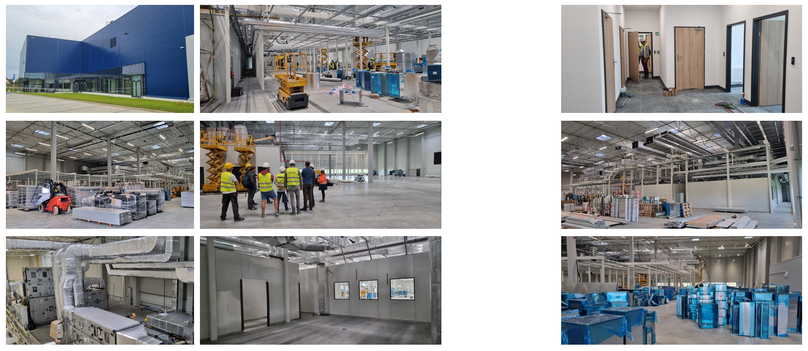
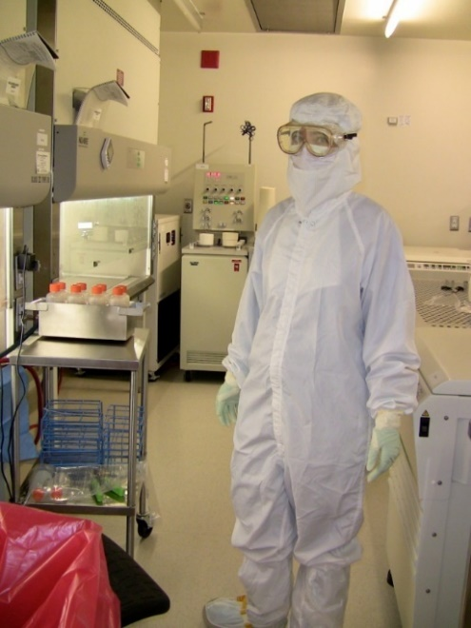
Poltreg’s Pharma Plant
cGMP Lab – certified manufacturing and product
Validated conditions
4.000 m²
And 2.100 m² of lab space
15 autonomic manufacturing lines
10 mln Euro
Which standard?
What is necessary?
www.poltreg.tech

Slide 14
ATMP- grade product with laboratory tools?
Natural T_{reg}
CD25^{high}CD4+
Natural T_{reg}
CD25^{high}CD4+
Natural T_{reg}
CD25^{high}CD4+
Natural T_{reg}
CD25^{high}CD4+
Natural T_{reg}
CD25^{high}CD4+
Natural T_{reg}
CD25^{high}CD4+
Natural T_{reg}
CD25^{high}CD4+
sorting
Natural T_{reg}
CD25^{high}CD4+
Natural T_{reg}
CD25^{high}CD4+
Natural T_{reg}
CD25^{high}CD4+
Natural T_{reg}
CD25^{high}CD4+
Natural T_{reg}
CD25^{high}CD4+
Natural T_{reg}
CD25^{high}CD4+
expansion
Natural T_{reg}
CD25^{high}CD4+
Natural T_{reg}
CD25^{high}CD4+
Natural T_{reg}
CD25^{high}CD4+
Natural T_{reg}
CD25^{high}CD4+
Natural T_{reg}
CD25^{high}CD4+
Natural T_{reg}
CD25^{high}CD4+
GMP
quality
check
Batch
release
www.poltreg.tech

Slide 15
ATMP- grade product with laboratory tools?
CD127
CD54
CD49d
CD39
CD73
CD27
CD45RA
CD45RB^{low}
CD152 (CTLA-4)
TGFβ/LAP
GITR
PDL
CD103
CXC4
CXC8
CD19
CD3
CD56
Natural T_{reg}
CD25^{high}CD4+
CD4
CD16
CD25 high
CD8
CD62L
The best found phenotype:
CD3⁺ CD4⁺ CD25^{high} CD127⁻ Lin⁻ doublet ⁻
Trzonkowski P et al. Cytometry A 2009
www.poltreg.tech

Slide 16
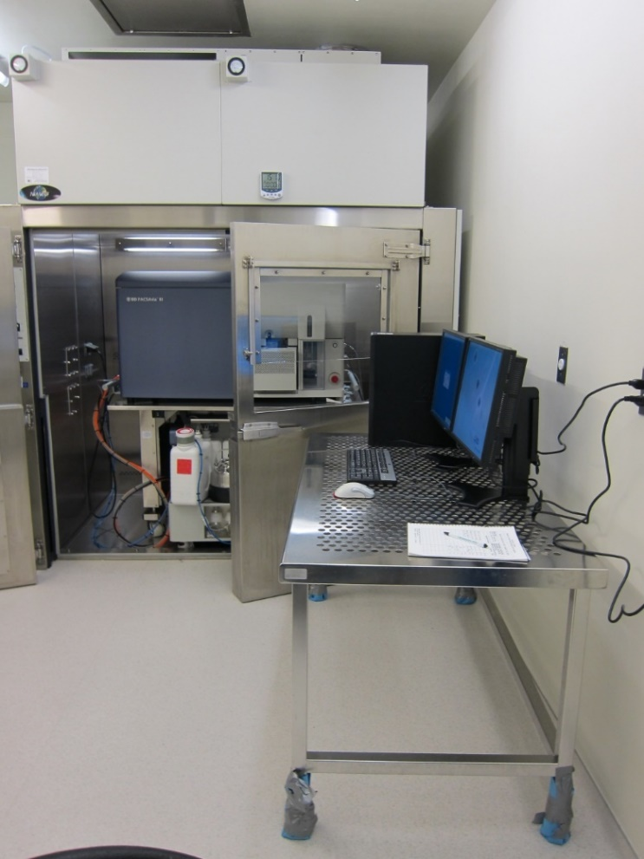
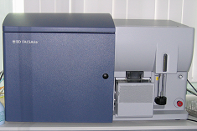
ATMP- grade product with laboratory tools?
Cross-contamination problem!!!
Working procedure for sterile sort with exchanged fluidics and sample lines
Single-use bags
Trzonkowski P et al. Cytometry A 2009
www.poltreg.tech

Slide 17
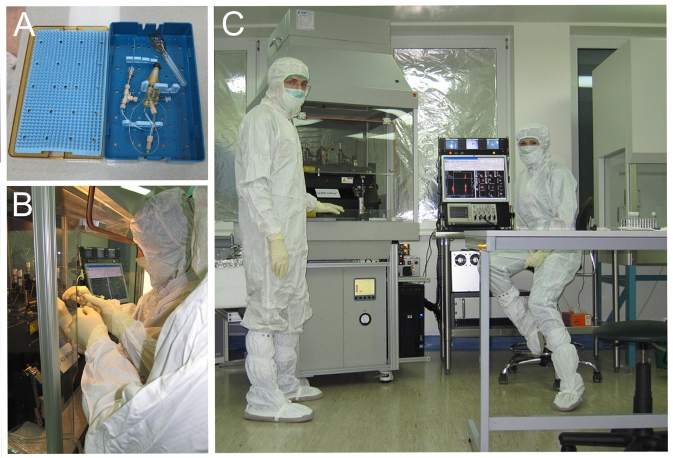
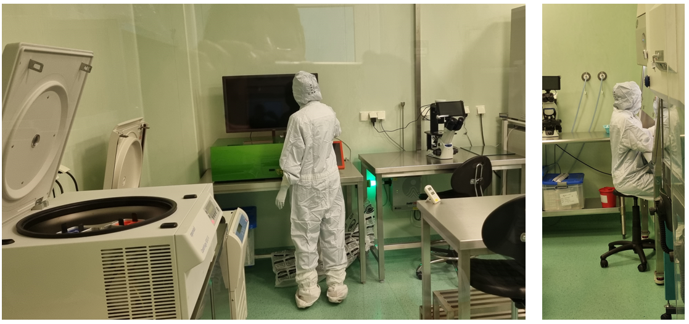
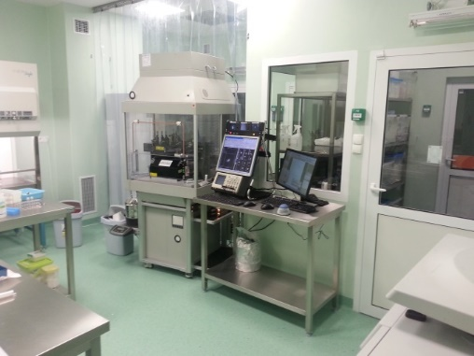
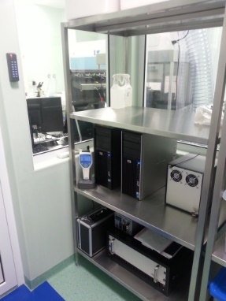
FACS sorter or immunomagnetic sorting?
Single-use
lines
HEPA
enclosure
www.poltreg.tech

Slide 18
Clinical trials are long
→ It is good to know where to go….Is it worth going there?
Preclinical models
Toxicity Pharmacokinetics
ADME
In vitro
studies
GMP formulation
Clinical trials
The need
Idea
Aim
ITF
PRIME
www.poltreg.tech

Slide 19
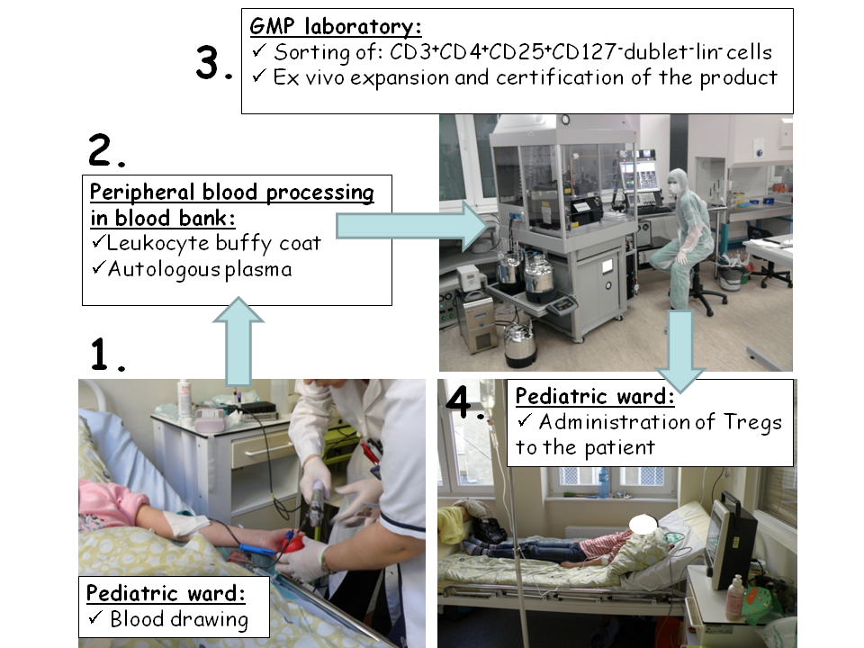
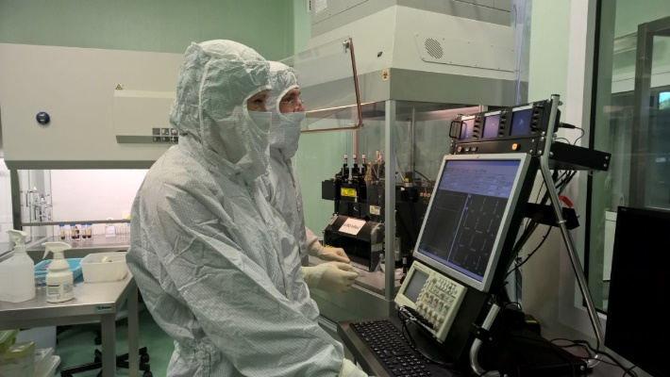
TregVac 1.0
Marek-Trzonkowska P et al. Diabetes Care 2012
www.poltreg.tech

Slide 20

TregVAC1.0 - Safe and efficacious
TREATED
NOT
TREATED
Marek-Trzonkowska P et al. J Transl Med. 2016
www.poltreg.tech

Slide 21
Two years follow-up?
Too short
Too few patients
ITF
PRIME
www.poltreg.tech

Slide 22
Results – long-term efficacy
TREATED
NOT
TREATED
Marek-Trzonkowska P et al. J Transl Med. 2016
www.poltreg.tech

Slide 23
TregVac 2.0
EudraCT 014-004319-35 (phase II)
Tregs
Modified Inclusion criteria
Tregs + antiCD20 therapy
Control NOT Tregs treated
www.poltreg.tech

Slide 24
Remission
Tregs+ antiCD20
Tregs
antiCD20
control
Zielinski et al. DOM 2022
www.poltreg.tech

Slide 25
Is my drug safe for my patients?
Is my drug efficacious?
Will my patients buy my drug (health technology assessment)?
Preclinical models
Toxicity Pharmacokinetics
ADME
Authorisation
(MAA)
(BLA)
In vitro
studies
GMP formulation
Clinical trials
The need
Idea
Aim
SA
www.poltreg.tech

Slide 26
TregVac 2/3
2x Tregs (3months apart) + antiCD20 therapy
Tregs (multiple doses – decision based on MMTT) [+ antiCD20 therapy?]
Inclusion criteria
2x Tregs (3months apart) only
antiCD20 therapy only
Control NOT Tregs treated
Inclusion criteria allows including only the patients in a very early phase of type 1 diabetes, mainly: fasting c-peptide above 0.8ng/ml and at least 100% increase in c-peptide levels after the challenge in MMTT
Five arms:
ARM 1 – two doses of TREGS 3 months apart (2 x 30x10⁶ Tregs per kg b.w.) and four doses of anti-CD20 (rituximab) in between (375 mg/m² at days: +14, +22, +29 and +36)
ARM 2 – multiple doses of TREGS (30x10⁶ Tregs per kg b.w. per dose) – decision based on MMTT (?) and four doses of anti-CD20 (rituximab) in between (375 mg/m² at days: +14, +22, +29 and +36) – add antiCD20?
ARM 3a – two doses of TREGS 3 months apart (2 x 30x10⁶ Tregs per kg b.w.)
ARM 3b – four doses of anti-CD20 (rituximab) (375 mg/m² at days: +14, +22, +29 and +36)
ARM 4 – control group treated with insulin only
5 years follow up
www.poltreg.tech

Slide 27
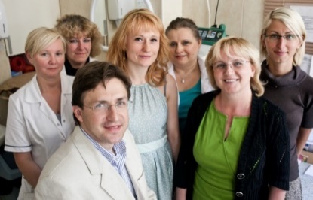
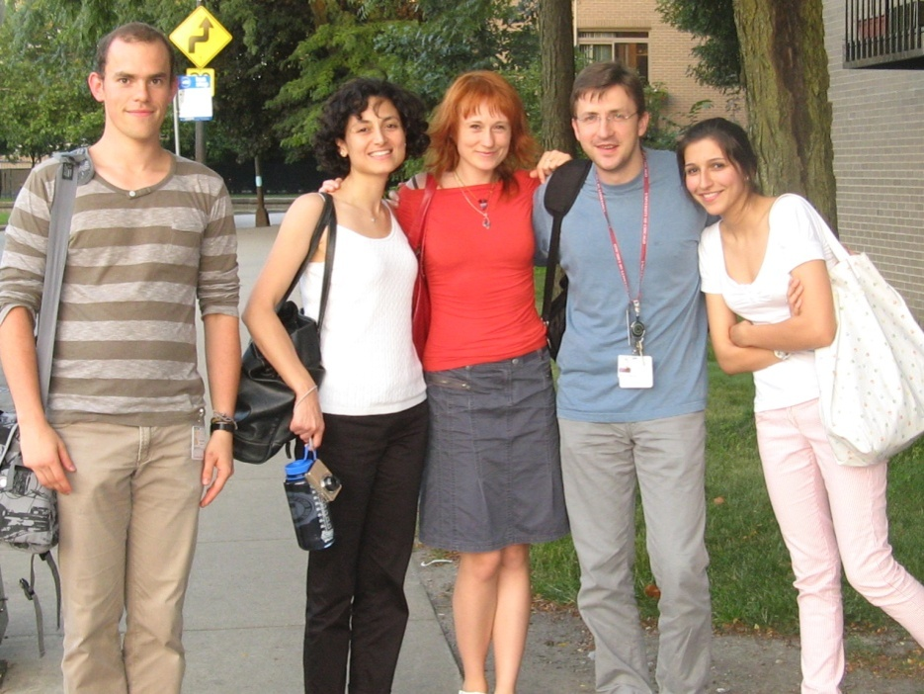
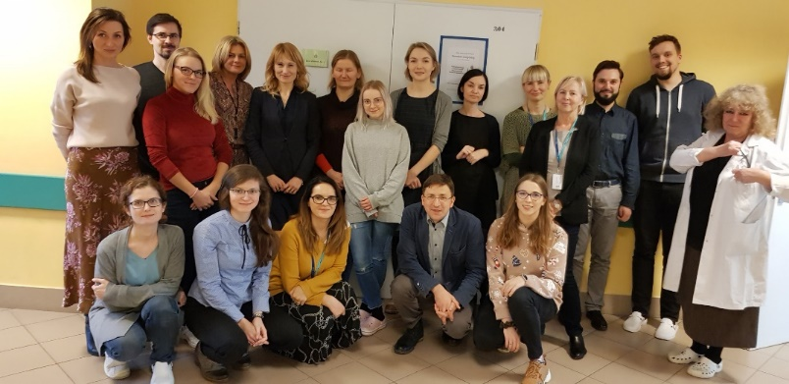
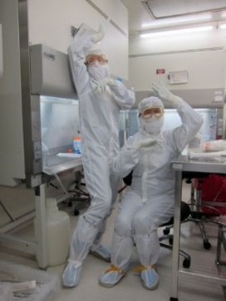
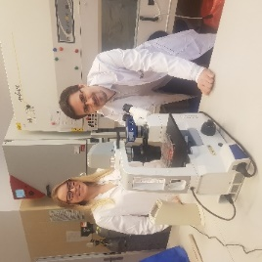
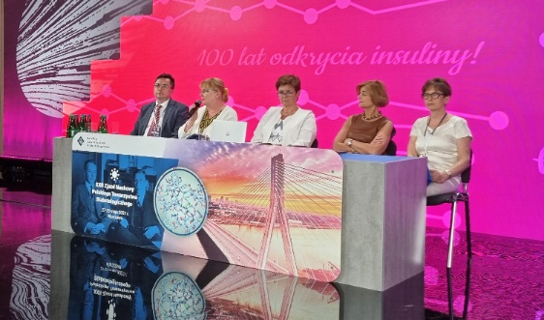
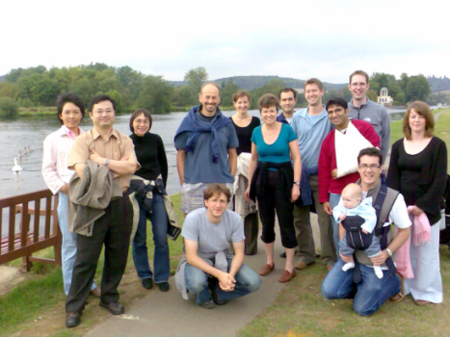
Authors
Katedra i Zakład Immunologii Medycznej, GUMed
Maciej Zielinski, Dorota Iwaszkiewicz-Grześ, Mateusz Gliwinski, Anita Dobyszuk, Anna Dukat-Mazurek, Marcelina Grabowska, Hanna Zielińska, Justyna Sakowska, Magdalena Piotrowska, Grażyna Gniłka
Zakład Medycyny Rodzinnej, International Centre for Cancer Vaccine Science, University of Gdańsk
Natalia Marek-Trzonkowska, Janusz Siebert
Katedra i Klinika Pediatri Diabetologii Endokrynologii, GUMed
Małgorzata Myśliwiec, Malgorzata Żalińska, Matylda Hennig, Anna Wołoszyn-Durkiewicz, Lucyna Szumacher-Sharma, Agnieszka Brandt, Ilona Derkowska, Radosław Owczuk, Anna Balcerska
Katedra Pediatrii Onkologii Hematologii i Diabetologii, UM Łódź
Wojciech Młynarski, Agnieszka Szadkowska, Beata Mianowska
Katedra Pediatrii i Diabetologii, UM Gliwice
Przemysława Jarosz-Chobot, Halla Kamińska
Katedra Pediatrii i Diabetologii, UM Białystok
Artur Bossowski
Koc University, Turkey
Seda Kizilel, Ipek Ergenc
Charité– Universitätsmedizin Berlin,
Vogt Katrin, Sawitzki Birgit
University of Oxford, UK
Kathryn Wood, Douglas Wu,
Joanna Hester, Satish Nadig
Technische Universität Dresden,
Anne Eugster, Andreas Dahl
Poltreg SA
Mariusz Jabłoński, Kamilla Bok, Marcin Szuba,
Ewa Szmit-Kosińska, Anna Biegaj
Parexel Int,
Claire Browne, Bridget Heelan, Mateusz Skowron
Weyer GmbH
Jennifer Dugas-Ford, Liang Gao, Joachim Kind

Slide 28

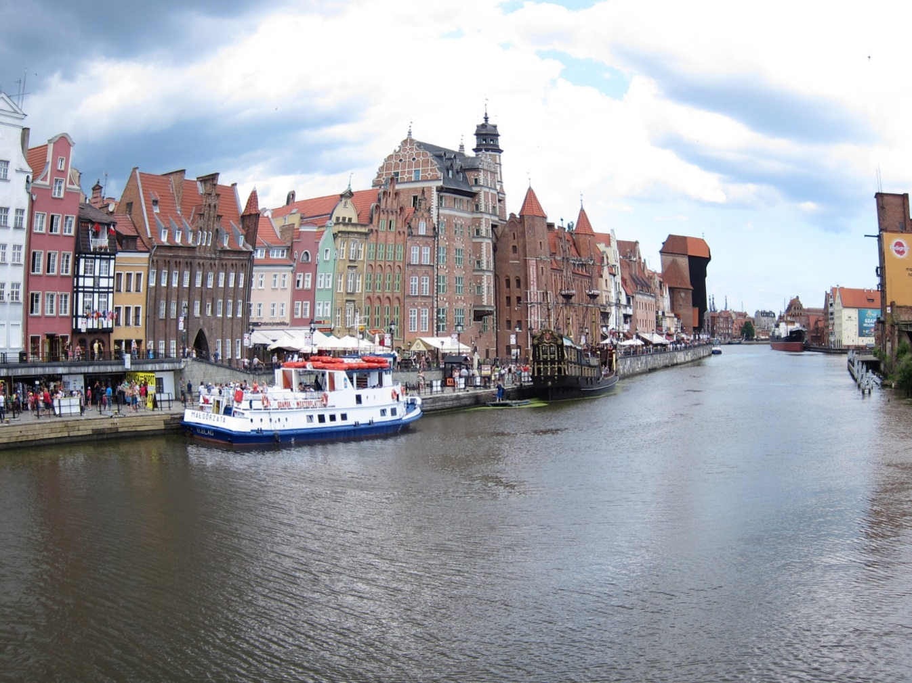
Thank you - Dziękuję
www.poltreg.tech

